Slide 1
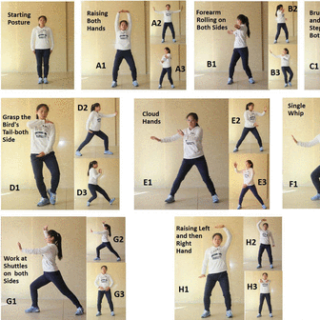
VERNON WALKING AND LIGHT EXERCISE GROUP
STARTS
SEPTEMBER 14TH
Mondays the Thursdays
9:30am to 10:30am
Come on out and have some fun!
This Photo by Unknown Author is licensed under CC BY-NC

